Slide 1


TECHNICAL COMMUNICATION (KAS – 301)
UNIT – 2
TOPIC : 7 Cs of effective business writing
Presented by
Dr. RENUKA
Assistant professor
Applied Science and Humanities
IMS Engineering College, Ghaziabad

Slide 2
Unit - II Forms of Technical Communication
Technical Report: Definition & importance
Thesis/Project writing: structure & importance
synopsis writing: Methods
Technical research Paper writing: Methods & style
Seminar & Conference paper writing
Expert Technical Lecture: Theme clarity; Analysis & Findings
7 Cs of effective business writing
C.V./Resume writing
Technical Proposal: Types, Structure & Draft.

Slide 3
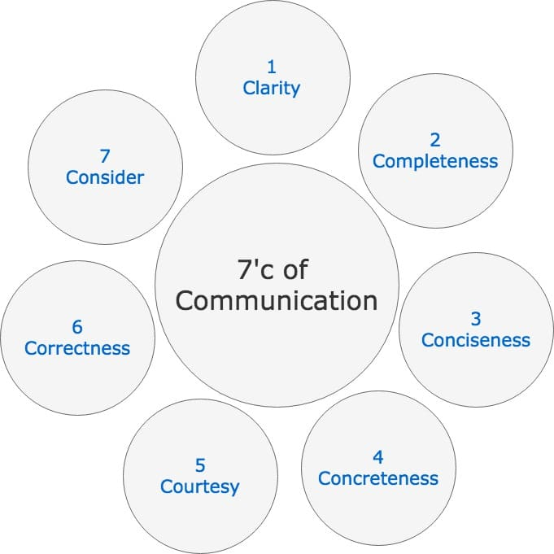

Slide 4
1. CLARITY
The message should be clear and easily understandable to the recipient.
The purpose of the communication should be clear to sender then only the receiver will be sure about it.
The message should emphasize on a single goal at a time and shall not cover several ideas in a single sentence.
Clarity in communication has following features:
It makes understanding easier.
Complete clarity of thoughts and ideas enhances the meaning of message.
Clear message makes use of exact, appropriate and concrete words.

Slide 5
2. COMPLETENESS
The communication must be complete. It should convey all facts required by the audience. The sender of the message must take into consideration the receiver’s mind set and convey the message accordingly.
A complete communication has following features:
Complete communication develops and enhances reputation of an organization.
Moreover, they are cost saving as no crucial information is missing and no additional cost is incurred in conveying extra message if the communication is complete.
A complete communication always gives additional information wherever required. It leaves no questions in the mind of receiver.
Complete communication helps in better decision-making by the audience/readers/receivers of message as they get all desired and crucial information.
It persuades the audience.

Slide 6
3. CONCISENESS
Conciseness means wordiness, i.e., communicating what you want to convey in least possible words without forgoing the other C’s of communication. Conciseness is a necessity for effective communication.
Concise communication has following features:
It is both time-saving as well as cost-saving.
It underlines and highlights the main message as it avoids using excessive and needless words.
Concise communication provides short and essential message in limited words to the audience.
Concise message is more appealing and comprehensible to the audience.
Concise message is non-repetitive in nature

Slide 7
4. CONCRETENESS
Concrete communication implies being particular and clear rather than fuzzy and general. Concreteness strengthens the confidence.
Concrete message has following features:
It is supported with specific facts and figures.
It makes use of words that are clear and that build the reputation.
Concrete messages are not misinterpreted

Slide 8
5. COURTESY
Courtesy in message implies the message should show the sender’s expression as well as should respect the receiver. The sender of the message should be sincerely polite, judicious, reflective and enthusiastic.
Courteous message has following features:
Courtesy implies taking into consideration both viewpoints as well as feelings of the receiver of the message.
Courteous message is positive and focused at the audience.
It makes use of terms showing respect for the receiver of message.
It is not at all biased.

Slide 9
6. CORRECTNESS
-Correctness in communication implies that there are no grammatical errors in communication.
Correct communication has following features:
The message is exact, correct and well-timed.
If the communication is correct, it boosts up the confidence level.
Correct message has greater impact on the audience/readers.
It checks for the precision and accurateness of facts and figures used in the message.
It makes use of appropriate and correct language in the message

Slide 10
7. CONSIDERATION
-Consideration implies “stepping into the shoes of others”. Effective communication must take the audience into consideration, i.e., the audience’s view points, background, mind-set, education level, etc. Make an attempt to envisage your audience, their requirements, emotions as well as problems. Ensure that the self-respect of the audience is maintained and their emotions are not at harm. Modify your words in message to suit the audience’s needs while making your message complete. Features of considerate communication are as follows:
Emphasize on “you” approach.
Empathize with the audience and exhibit interest in the audience. This will stimulate a positive reaction from the audience.
Show optimism towards your audience. Emphasize on “what is possible” rather than “what is impossible”. Lay stress on positive words such as jovial, committed, thanks, warm, healthy, help, etc.

